Slide 1


Data Analytics

Slide 2


Today's agenda
Project recap
Problem
The Analytics team
Process
Insights
Summary
Notes:
The Agenda for today will be as follows:
1. To provide a high-level understanding of the business challenge we're handling and the specific needs, we shall summarise the project as a whole.
2. We will get into the specific problem that the Data Analytics team has been concentrating on and provide some explanation for why this is such a significant issue.
3. After outlining the issue, I'll discuss the team in charge of handling it from our perspective.
4. To give you an in-depth knowledge of how we approach tasks of this kind, I will next go through the high-level procedure that we used to finish this work.
5. To wrap up, I'll go through the most important findings and offer them as a collection of learnings and visualizations from our investigation.
I'll conclude up and leave the discussion open for any questions.

Slide 3

Social Buzz is a fast growing technology unicorn that need to adapt quickly to it's global scale. Accenture has begun a 3 month POC focusing on these tasks:
An audit of Social Buzz's big data practice
Recommendations for a successful IPO
Analysis to find Social Buzz's top 5 most popular categories of content
Project Recap

Slide 4


Problem
The client has reached a massive scale within recent years and does not have the resources internally to handle it.
Social Buzz receives over 100000 posts per day which amounts 36,500,000 posts every year, of which this all unstructured data making it very hard to make a sense.
Identify the requirements that need to be delivered for this project.
Merging of sample data set tables
An analysis of their content categories that highlights the top 5 categories with the largest aggregate popularity

Slide 5



Andrew Fleming
Chief Technology Architect
The Analytics team
Marcus Rompton
Senior Principal
Amey Desai
Data Analyst
Notes:
In terms of experience, Accenture has a significant data analytics practice, however we had a team of 3 employees who were mostly responsible for this work.
Our chief technical architect, Andrew Fleming, provided invaluable guidance to the team in order to deliver high-quality analyses.
Senior data specialist Marcus Rompton took an active role in the data engineering part of this project and has worked with some of the largest companies in the world to solve their data difficulties.
Last but not least, it was up to me, Amey Desai, to take the leadership's direction, produce excellent insights from the raw information, and then transform those insights into decision-making for the company.

Slide 6
Process
1
Data Understanding
MICROSOFT EXCEL
2
Data Cleaning
3
Data Modelling
4
Data Analysis
TABLEAU
5
Uncover Insights
Notes:
However, we went at it in five phases:
1. Data understanding:- An in-depth understanding of the data is essential for every data effort to succeed. Therefore, we made an effort to understand your business's data model and domain.
2. Data cleaning:– after researching your company, we cleaned the datasets that were already there and evaluated what the best dataset for the problem would be.
3. Data modeling - After making sure the data was clean and sufficient for analysis, we had to process and model it to create a dataset that could respond to the queries raised by the company and deliver the desired outcomes.
4. Data analysis - We used our new dataset and our analytical knowledge to derive insights from it and to create visualizations that would help explain our findings.
5. Uncover Insights:- Finally, we made suggestions for the following actions and used these insights to make business decisions.

Slide 7

Insights
16
75K
January
(Animals)
UNIQUE CATEGORIES
Category With Highest Score
MONTH WITH
MOST POSTS
Notes:
Our analysis of your data revealed that your sample dataset had posts in a total of 16 different categories. Food, culture, and sport are included in this.
Additionally, there was a score of 75K Highest posts from the animal category! It's clear that people love animals.
Additionally, January was the month in which people posted the most often. This fits with seasonal tendencies among social media users who feel the urge to reconnect with friends following significant calendar events like Christmas.
The primary question, though, is: Which were the top 5 most popular posts categories?

Slide 8
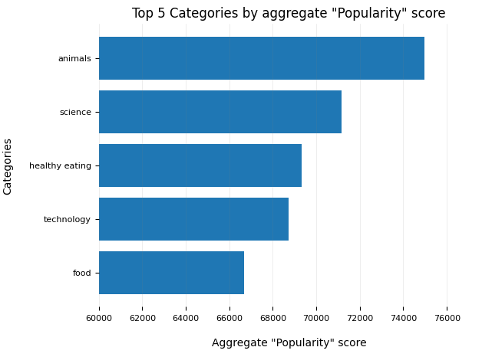
Notes:
According to our study, the top 5 most popular post categories were, in descending order, animals, science, healthy eating, technology, and food.
The overall popularity score for animals was about 74965. Food is an extremely compelling content area, as seen by the inclusion of both food and healthy eating in the top 5. Your user base may be skewed towards healthy eaters and those who are concerned about their health since healthy eating scores just a little bit higher than food.
It's also interesting to watch how science and technology have advanced. This may indicate that individuals prefer reading articles with facts and little pieces of information they may learn from.

Slide 9
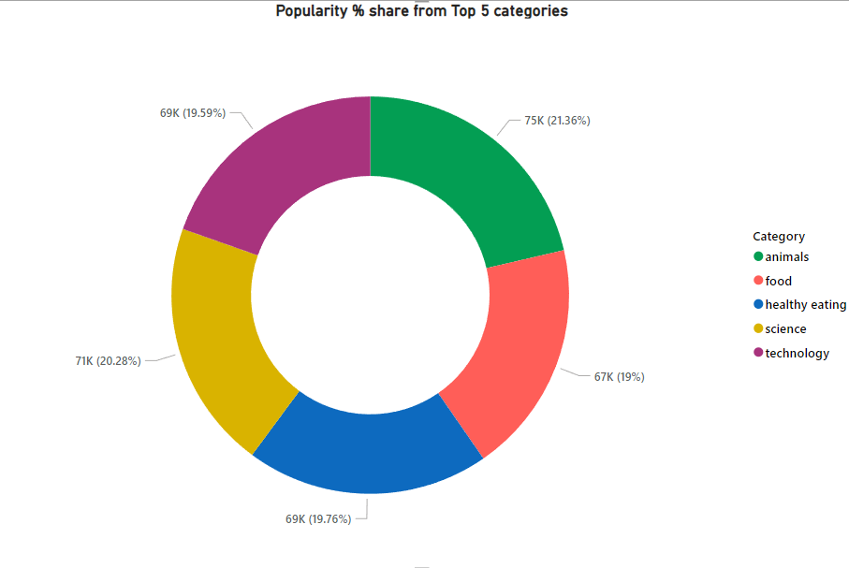
Notes:
This figure additionally displays the popularity divide between the top 5 categories in percentage terms. The percentage of each category varies just a little, but the 1.1% difference between the first- and second-most popular categories—animals and science—is the biggest.
In terms of business, this would indicate that the most popular category, animals, is starting to lag behind the others and might even continue to gain popularity. It will be crucial for you to make sure that any algorithms used to control the material on the platform offer a proper balance to the content categories in order to avoid a situation where one content category takes in the entire platform.

Slide 10

ANALYSIS
Animals and science are the two most popular categories of content, showing that people enjoy "real-life" and "factual" content the most.
INSIGHT
Food is a common theme with the top 5 categories with "Healthy Eating" ranking the highest. This may give an indication to the audience within your user base. You could use this insight to create a campaign and work with healthy eating brands to boost user engagement.
Summary
NEXT STEPS
This ad-hoc analysis is insightful, but it's time to take this analysis into large scale production for real-time understanding of your business. We can show you how to do this.
Notes:
So to summarize it:
We took on this responsibility and, as requested, identified the top five most popular categories, but we also went a step further.
- We discovered that the two most popular categories are animals and science, indicating that consumers prefer "real-life" and "factual" information.
- We also discovered that food was a recurring topic in popular material, with healthy eating being the most well-liked food category. This might be a clue of the sorts of users your platform is attracting, and you could utilize this knowledge to increase engagement even further. For instance, you might create a campaign with content centered on this particular field or collaborate with companies that encourage healthy eating to promote content.

Slide 11

Thank you!
ANY QUESTIONS?
Notes:
Thank you very much for listening, please feel free to ask any questions that you may have!

